Slide 1
Why are we here, why are we together?

Slide 2
Why the Cerrado Group?
Why does it matter to the members?
Why does it matter to our competition?
Why does it matter to the recordkeepers?
Why does it matter to the advisors / broker dealers?

Slide 3
What is the Cerrado Group today?
A study group
Sharing best practices
Driving Scale:
Some co-marketing efforts
Materials
Cyber Audit
Distribution?
The capability to build, deliver and invest (time & money) beyond what any individual member could do on their own.

Slide 4
What the Cerrado Group is not
A way to:
Reduce or eliminate competition
Protect territory or dirt
Keep advisors to yourself
distribution
marketing

Slide 5
Common issues for Plan Consultants
Succession Plan
Scale
Assets to invest
Technology
Automation
Training
API
Cyber Security
Benefits
Increasing cost of
Branding
Distribution
Respect
Consolidation, proliferation of Private Equity and Venture Capital firms in our space

Slide 6
Common issues for Plan Consultants
Risk of a Cyber breach with a TPA firm
Recordkeeper consolidation
Broker Dealer distribution
The proliferation of automation and AI
Aggregators buying other TPAs, combination of Advisory, Recordkeeping and Plan Consultation and Compliance

Slide 7
Cash Flow is King / Queen – membership growth is necessary
Current expense = $150k
Current revenue = $220k membership and Sponsorship
Grow Membership
Membership growth drives influence and more sponsorship opportunity
15 @ $10,000.00 = $150,000.00 annually
covers expenses, no common investment
30 @ $10,000.00 = $300,000.00 annually
expense coverage, some investment
50 @ $10,000.00 = $500,000.00 annually
expense coverage, real investment
50 @ $15,000.00 = $750,000.00
expense coverage, real investment, employees

Slide 8
What Cerrado could be

Slide 9
A vision of a possible future
The capability to build, deliver and invest (time & money) beyond what any individual member could do on their own; and address other issues we all have while building additional revenue sources

Slide 10
A vision of a possible future
Today – Keep and evolve
Tomorrow – New Entity
Non-Profit
The Cerrado Group
Best Practices
Education
Charity
Eligibility for investment and ownership in the Cerrado Corporation
For Profit
The Cerrado Corporation
Our own private equity firm – fight fire with fire
Focus on common issues
Develop multiple revenue sources

Slide 11
The Cerrado Corporation - Example
10,000,000 total shares issued
$5 par value
Choice for member Owner / Equity Partner of Cerrado Group to purchase:
50,000 shares of Cerrado Corp
Minimum investment amount – $50 / 100k
Average investment $250,000.00
Members of the Cerrado Group are:
Shareholders
Possible Members of the board of directors
1 1 board members
7 Cerrado members
4 outside board members
Minimum 2 tech heavy
Cerrado Group members do not run or manage the Cerrado Corporation
Hire an Operations Manager
CEO

Slide 12
The Cerrado Corporation - Example
Example:
40 initial investing share holders
@ $250,000.00 = $10,000,000.00 seed money
Establish a banking, lending relationship for acquisition and line of credit
Members to provide necessary collateral
Leverage 3 – 4 : 1 - $30 to $40 M in lending assets
Each share holder will share in profits via
Long-term
Multiple revenue sources
Selling services, products and subscriptions to the industry
Over 200 M in annual revenue
Consistent dividend distribution to shareholders
Possible further monetization by selling treasury share to outside Venture Capital

Slide 13
The Cerrado Corporation
Each owner member of the Cerrado Group (non-profit) has the right to purchase shares of the Cerrado Corporation (for Profit)
Each member of the Cerrado Group agrees to the following:
Agree to give the Cerrado Corporation right of last refusal to purchase your firm if you decide to sell or devest
Provides a real succession option
Allows members to go to market for the best price
If you sell your business to Cerrado, you still have ownership in your sold firm

Slide 14
The Cerrado Corporation
Agree to use other Cerrado Holdings subsidiaries if services are used
Rollover Solution
3(16) outsourcing
Employee Outsourcing
Technology and Automation forward
Cerrado Group – non-profit hires the for profit for technology builds

Slide 15
Cerrado Consulting
The Cerrado
Corporation
Cerrado Trust
The Cerrado Standard
Cerrado Fiduciary Services
Cerrado Technologies
Cerrado Outsourcing
Cerrado
University
API
Payroll
Other
Cerrado Group share holder
Cerrado Group share holder
Cerrado Group share holder
Cerrado Group share holder
Cerrado Group share holder
the Cerrado Corporation

Slide 16
UNIQUE VALUE PROPOSITIONS
CAPITAL
MULTIPLE REVENUE STEAMS
The Cerrado Group
Private Equity Investment
We give money away everyday.
The Cerrado Corporation
Has to work for the advisor.
Has to work for the client
Has to work for our employees
Has to work for us
Non-profit
Recruiting Plan Consultants
Educate
Charity
For Profit
Start with common issues
TECHNOLOGY
SECESSION WITH A TAIL
Central Builds – Central systems and custom systems
Stay involved, keep a purpose .
INDEPENDENCE
BRAND / STRUCTURE / LEVERAGE
Like minded firms, maintain independent firms
Change the industry

Slide 17
The Cerrado Group …other opportunities
Benefits:
Health Insurance
Self Insured?
HR resources
Combined company meetings and trainings
Virtual
In person
Employee recognition
ERISA Attorney Resources

Slide 18
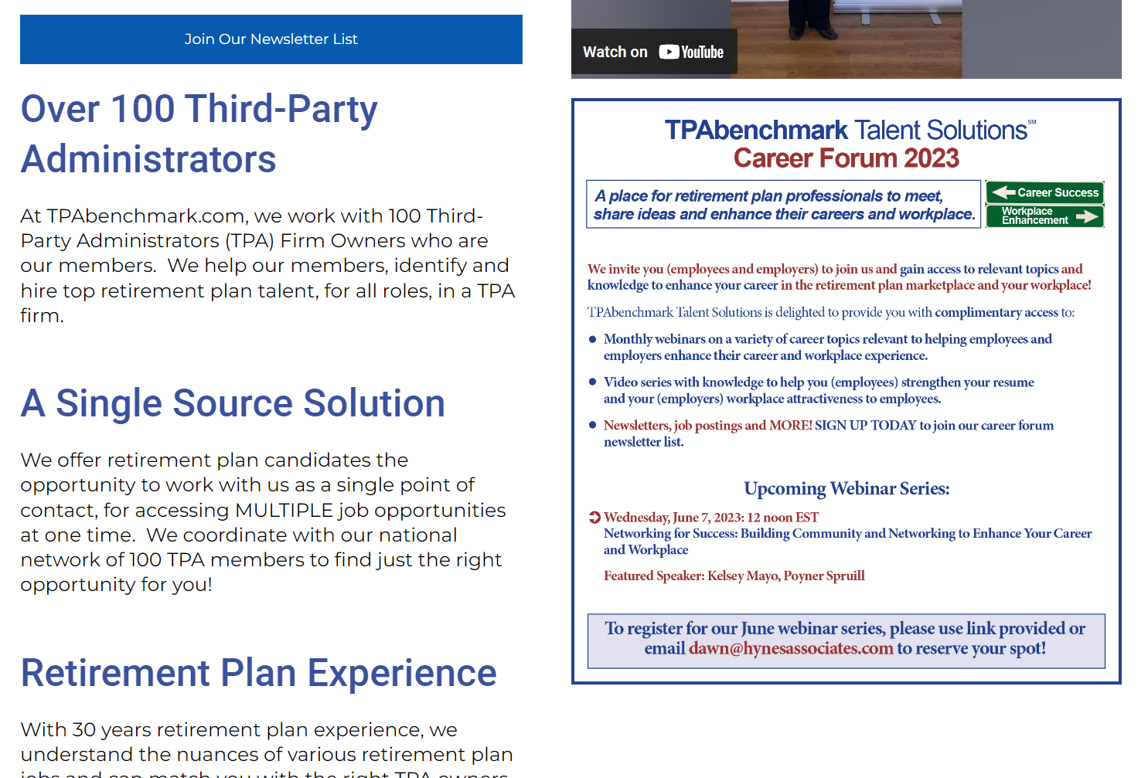
Competition – TPA Benchmarks

Slide 19
Competition – TPA Benchmarks
Through a combination of TPA-owner focused events to help our members GROW, advisor events to help our members connect with new distribution, and discounts to help members SAVE – we are committed to delivering value-added, bottom-line benefits to the TPA firm owners that we are privileged to call members of the TPAbenchmark.com community!
Through our Partnerships in ActionSM Events, we’ll help you (TPA firm owners) grow your sales through new partnerships.
Through our Strength in NumbersSM Program, you’ll derive valuable economic savings (discounts) on services that all TPAs need.
Through our Community in ActionSM, we’ll help you (TPA firm owners) turn ideas into action as an advocate for your (TPA firm owner) needs.
Through our Leadership in ActionSM initiative, we are excited to be making a difference in the next generation and giving back.

Slide 20
The Cerrado Standard
Benchmark for Plan Consulting Firms
Establish a standard that is recognized by recordkeepers and Broker Dealers for Plan Consulting firms for process, cyber security, training
All Cerrado Members must meet or exceed
Certify Non- Cerrado Plan Consulting Firms, for an annual cost.

